Slide 1
State Machines

Slide 2
State Machines
To model the behavior of any modelling element like class, usecase or entire system.
State machines can be visualized in two ways: First using Activity diagrams
Second using State chart diagrams.

Slide 3
Statechart diagram is used to capture the dynamic aspect of a system. State machine diagrams are used to represent the behavior of an application. An object goes through various states during its lifespan. The lifespan of an object remains until the program is terminated. The object goes from multiple states depending upon the event that occurs within the object. Each state represents some unique information about the object.

Slide 4
Statechart diagrams are used to design interactive systems that respond to either internal or external event. Statechart diagram in UML visualizes the flow of execution from one state to another state of an object.
It represents the state of an object from the creation of an object until the object is destroyed or terminated.

Slide 5
A state machine is a behavior that specifies the sequences of states an object goes through during its lifetime in response to events.
Graphically, a state is rendered as a rectangle with rounded corners. A transition is rendered as a solid directed line.
state machine are used to specify the behavior of objects that must respond to asynchronous stimulus or whose current behavior depends on their past.
state machines are used to model the behavior of entire systems, especially reactive systems, which must respond to signals from actors outside the system.

Slide 6
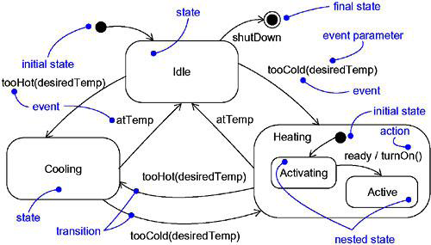


Slide 7
States
A state is a condition or situation during the life of an object during which it satisfies some condition, performs some activity, or waits for some event.
An object remains in a state for a finite amount of time. For example, a Heater in a home might be in any of four states: Idle, Activating, Active, and ShuttingDown.
a state name must be unique within its enclosing state

Slide 8
A state has five parts:
  Name,
  Entry/exit actions,
  Internal transitions – Transitions that are handled without causing a change in state,
  Substates – nested structure of a state, involving disjoint (sequentially active) or concurrent (concurrently active) substates.
  Deferred events – A list of events that are not handled in that state but, rather, are postponed and queued for handling by the object in another state

Slide 9
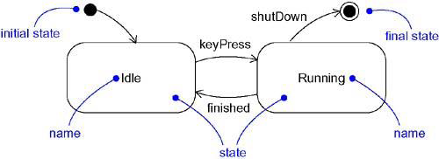

Slide 10
initial state indicates the default starting place for the state machine or substate and is represented as a filled black circle
final state indicates that the execution of the state machine or the enclosing state has been completed and is represented as a filled black circle surrounded by an unfilled circle
Initial and final states are pseudo-states

Slide 11
Transitions
A transition is a relationship between two states indicating that an object in the first state will perform certain actions and enter the second state when a specified event occurs and specified conditions are satisfied.
Transition fires means change of state occurs. Until transition fires, the object is in the source state; after it fires, it is said to be in the target state.
A transition may have multiple sources as well as multiple targets
A self-transitionis a transition whose source and target states are the same

Slide 12
A transition has five parts:
  Source state – The state affected by the transition,
  Event trigger – a stimulus that can trigger a source state to fire on satisfying guard condition,
  Guard condition – Boolean expression that is evaluated when the transition is triggered by the reception of the event trigger,
  Action – An executable atomic computation that may directly act on the object that owns the state machine, and indirectly on other objects that are visible to the object,
  Target state – The state that is active after the completion of the transition.

Slide 13
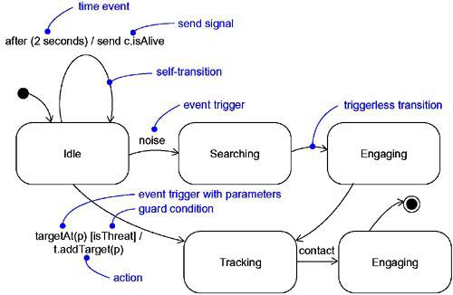

Slide 14
Event trigger
An event in the context of state machines is an occurrence of a stimulus that can trigger a state transition.
events may include signals, calls, the passing of time,or a change in state.
An event – signal or a call – may have parameters whose values are available to the transition, including expressions for the guard condition and action.
An event trigger may be polymorphic

Slide 15
Guard Condition
a guard condition is rendered as a Boolean expression enclosed in square brackets and placed after the trigger event
A guard condition is evaluated only after the trigger event for its transition occurs
A guard condition is evaluated just once for each transition at the time the event occurs, but it may be evaluated again if the transition is retriggered

Slide 16
Action
An action is an executable atomic computation i.e, it cannot be interrupted by an event and runs to completion.
Actions may include operation calls, the creation or destruction of another object, or the sending of a signal to an object
An activity may be interrupted by other events.

Slide 17
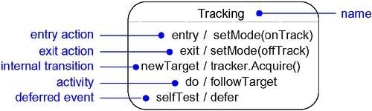
Advanced States and Transitions

Slide 18
Entry and Exit Actions
Entry Actions are those actions that are to be done upon entry of a state and are shown by the keyword event ‘entry’ with an appropriate action
Exit Actions are those actions that are to be done upon exit from a state marked by the keyword event ‘exit’, together with an appropriate action

Slide 19
Internal Transitions
Internal Transitions are events that should be handled internally without leaving the state.
Internal transitions may have events with parameters and guard conditions.

Slide 20
Activities
Activities make use of object’s idle time when inside a state. ‘do’ transition is used to specify the work that’s to be done inside a state after the entry action is dispatched.

Slide 21
Deferred Events
A deferred event is a list of events whose occurrence in the state is postponed until a state in which the listed events are not deferred becomes active, at which time they occur and may trigger transitions as if they had just occurred.
A deferred event is specified by listing the event with the special action ‘defer’.

Slide 22
Substates
A substate is a state that’s nested inside another one.
A state that has substates is called a composite state.
A composite state may contain either concurrent (orthogonal) or sequential (disjoint) substates.
Substates may be nested to any level

Slide 23
Sequential Substates
Sequential Substates are those substates in which an event common to the composite states can eaisly be excercised by each states inside it at any time
sequential substates partition the state space of the composite state into disjoint states
A nested sequential state machine may have at most one initial state and one final state

Slide 24
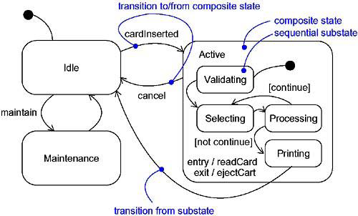
Sequential Substates

Slide 25
History States
A history state allows composite state that contains sequential substates to remember the last substate that was active in it prior to the transition from the composite state.
a shallow history state is represented as a small circle containing the symbol H
The first time entry to a composite state doesn’t have any history and the process for collecting history is as shown in the figure
the symbol H designates a shallow history, which remembers only the history of the immediate nested state machine.
the symbol H* designates deep history, which remembers down to the innermost nested state at any depth.
When only one level of nesting, shallow and deep history states are semantically equivalent.

Slide 26
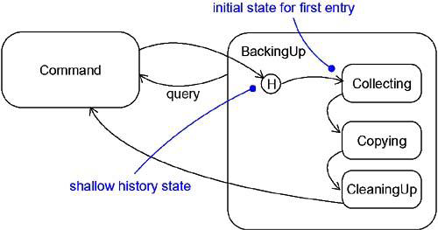
History States

Slide 27
Concurrent Substates
concurrent substates specify two or more state machines that execute in parallel in the context of the enclosing object
Execution of these concurrent substates continues in parallel. These substates waits for each other to finish to joins back into one flow
A nested concurrent state machine does not have an initial, final, or history state

Slide 28
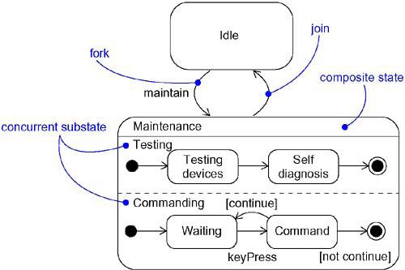
Concurrent Substates

Slide 29
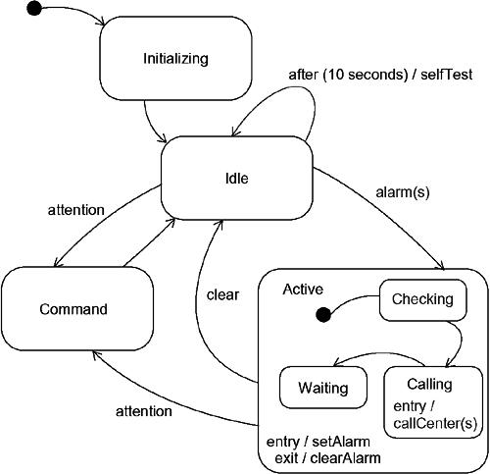
Modeling the lifetime of an object

